Slide 1
Examining Vehicle Suspension Elements to Best Design a Comfortable Ride
ME 4534
Group 2
Sarae Ang, BSME 2017*
Steven Chung, BSME 2017*
Michael Lam, BSME 2017*
Brandon Nguyen, BSME 2017*
*Hopefully
Notes:
Good Afternoon
We’re team (Insert Number)

Slide 2
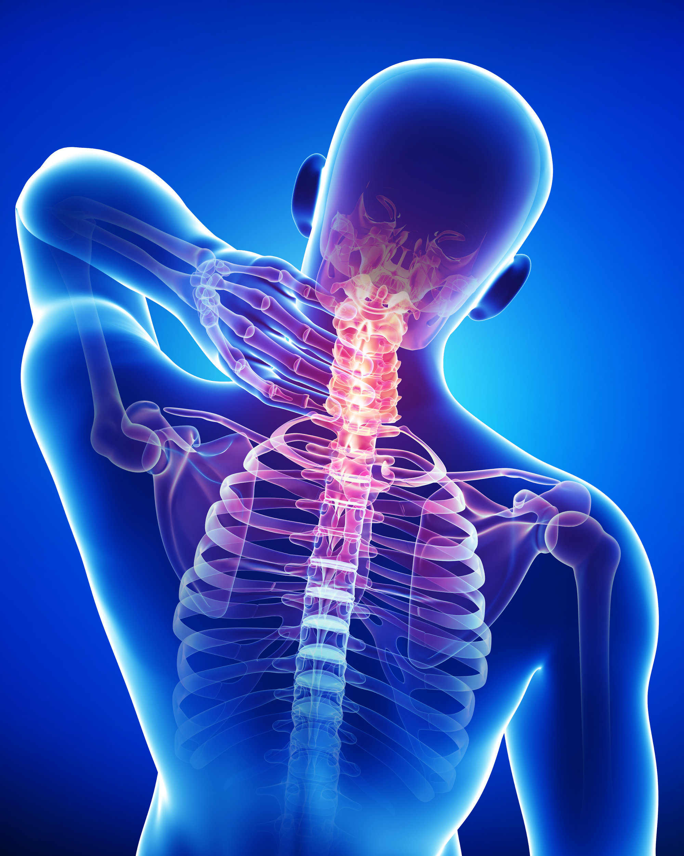
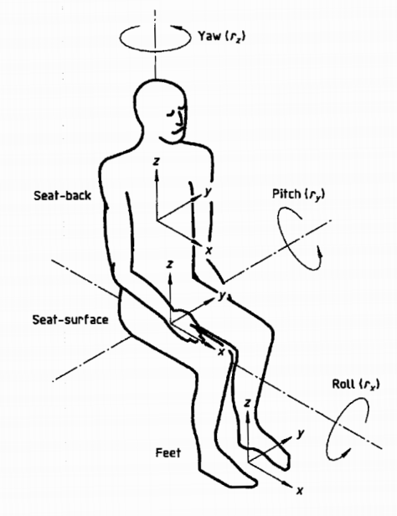
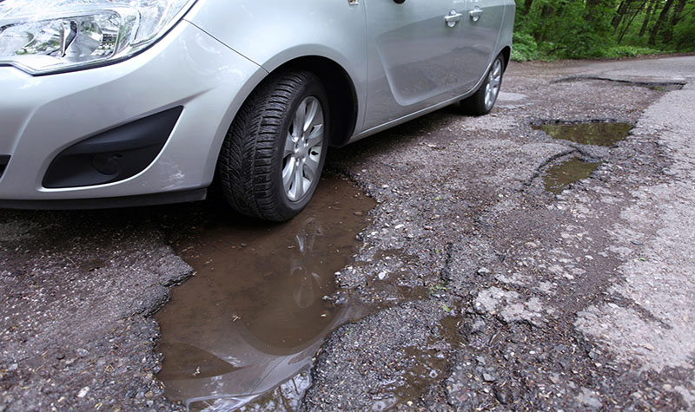
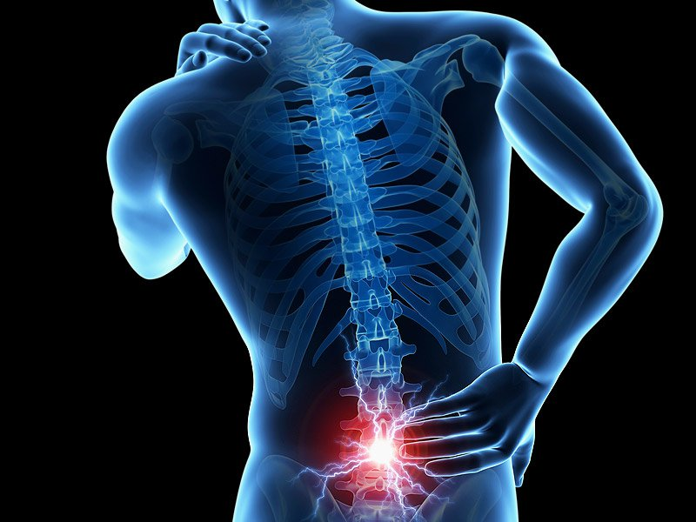
Why is Ride Comfort important?
ME 4534
Driver Health
Road Conditions
Driver Orientation
Notes:
-Ride comfort correlates to car safety.
-Sources of discomfort include oscillations from road roughness and tire/wheel assembly.
-Whole Body Vibration is a factor of Lower Back Pain
- Ride comfort a critical feature in vehicle design in the past years
ISO 2631-1: 1997(E)
Human: Land Vehicle Image
Road Image: http://werankcities.com/wp-content/uploads/2015/05/8.jpg
Neck Pain: http://www.osteopathy.org/wp-content/uploads/2014/04/A8_What_Osteopathy_Treats_26852014.jpg
Back Pain: http://azneuromod.com/wp-content/uploads/2016/02/back-pain-spine.jpg

Slide 3


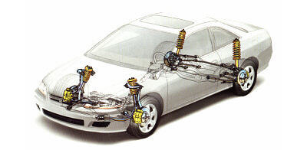
Ride Comfort is determined by RMS Acceleration
ME 4534
Data and Trends
Suspension
Road Inputs
Notes:
-How can we measure ride comfort? Comfort is directly related to the body acceleration
-Road bumps treated inputs which is then modelled into a computer
-Adjust the suspension (vary stiffness and suspension) (take RMS)
-Plot the data and the trends to get consensus
While determining the ideal traits, we don’t want to compromise the vehicle handling and performance
Bumpy Road: https://aotw-pd.s3.amazonaws.com/styles/aotw_detail_ir/s3/images/michurin_euroshina_speedbump_poster.jpg?itok=hImEKxR4
Car Suspension: http://s.hswstatic.com/gif/car-suspension-12.jpg
Trend: http://searchengineland.com/figz/wp-content/seloads/2015/10/graph-line-trend-analytics-magnifying-glass-ss-1920.jpg

Slide 4
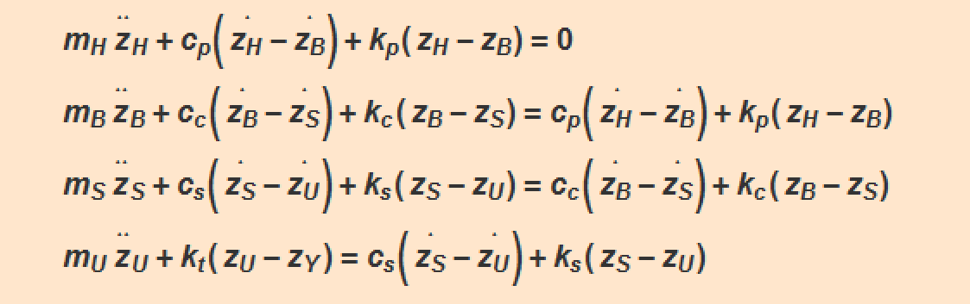
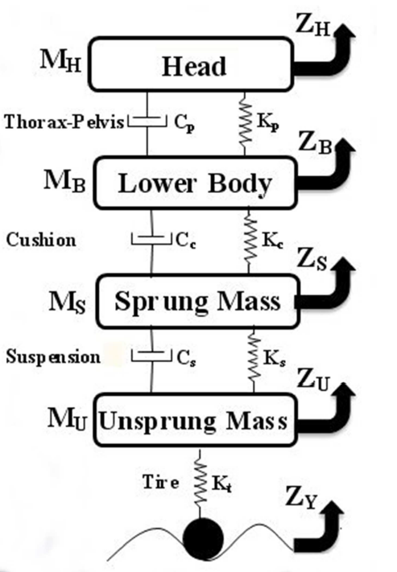
Ride Comfort is examined using the Quarter Model
ME 4534
Mitra & Benerjee, “Ride Comfort of Quarter Car Model using SIMULINK and Bond Graph”, 2013
Mathematica → GOOD for manipulating equations but BAD for retrieving response data!
Notes:
How: How will we attack this problem?
-Dynamic model + EOM’s
-Essentially a spring mass damper system with 4 degrees of freedom.
-Observe road inputs on head and lower body.
-Motion will be in the Z direction, which is in the vertical. We don’t want to overcomplicate our system is the reason.
Solve equations for Z_ddot. Show the dependencies (Zy->Zu->Zs->Zb->Z)
Method in Mathematica is utilizing superposition principle, which is justified since our model is linear. Movement only in the vertical direction due to road bump input. Way that we derived the equations and how Mathematica processes them is inefficient. Sluggish and takes too long.

Slide 5

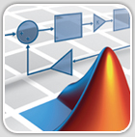
Modeling with MATLAB and Simulink
ME 4534
Step 1: Initialize Parameters
Step 2: Run Simulation
Step 4: Retrieve Plots
Step 3: Export Data
Notes:
Why is Matlab the ultimate choice?
It is an industry standard and ubiquitous in the automotive industry, especially for Model Based Design
Matlab initializes the files and required parameters
Simulink receives the m file and runs simulation
Simulink export the data
Matlab retrieves and generates plots

Slide 6

Simulations were run for two separate cases
ME 4534
CASE 1: Varying Suspension Damping
Mass
Stiffness, K
CASE 2: Varying Suspension Stiffness
Damping, B
Head and Upper Body
20 kg
45 kN/m
1360 N*s/m
Lower Body and seat
45 kg
20 kN/m
1649 N*s/m
240 kg
10 kN/m
5 -> 25 kN/m
500 -> 3000 N*s/m
Suspension
1650 N*s/m
Unsprung Mass
36 kg
160 kN/m
---
Mitra & Benerjee, “Ride Comfort of Quarter Car Model using SIMULINK and Bond Graph”, 2013
Notes:
Picked these values based on previous ride comfort study
Values aren’t too far apart from other sources. Feasible!

Slide 7
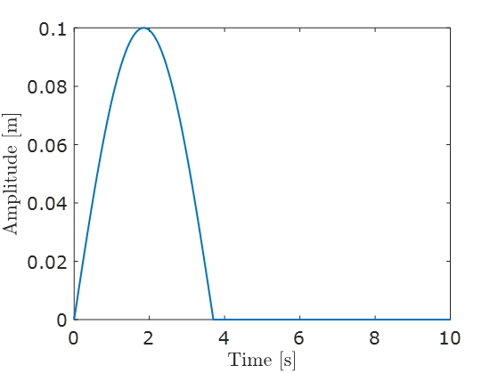
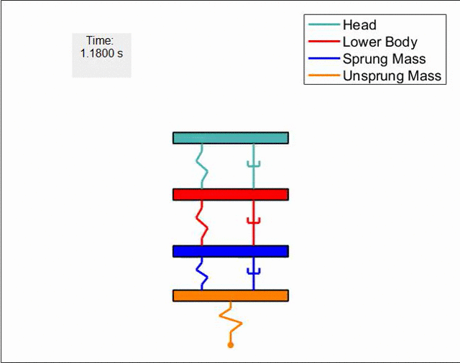
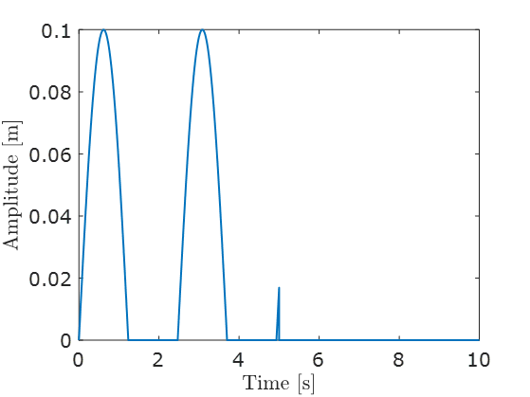
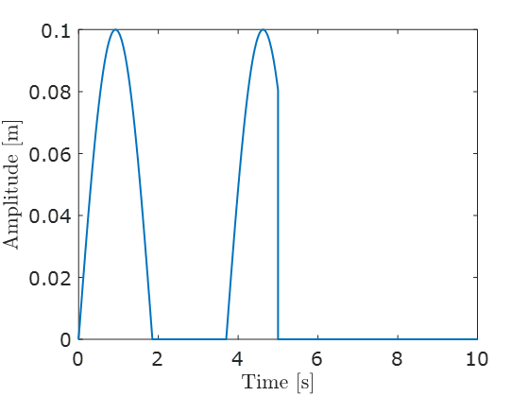
For both cases, Simulations were run 50 times at different velocities for bump inputs
ME 4534
2 m/s
3 m/s
At 1 m/s
Velocity = 1 -> 50 m/s
RMS Values
Notes:
-Simulate going over bumps at every velocity from 0 to 50 m/s for 50 samples… the figure shows just ONE of the bumps!!
-RMS SHOWS GENERAL TREND
-10 SECOND SIMULATION
-Bump input lasts for 2.8 seconds
-Response is only in the vertical axis
-Animation for constant cs, vary ks

Slide 8
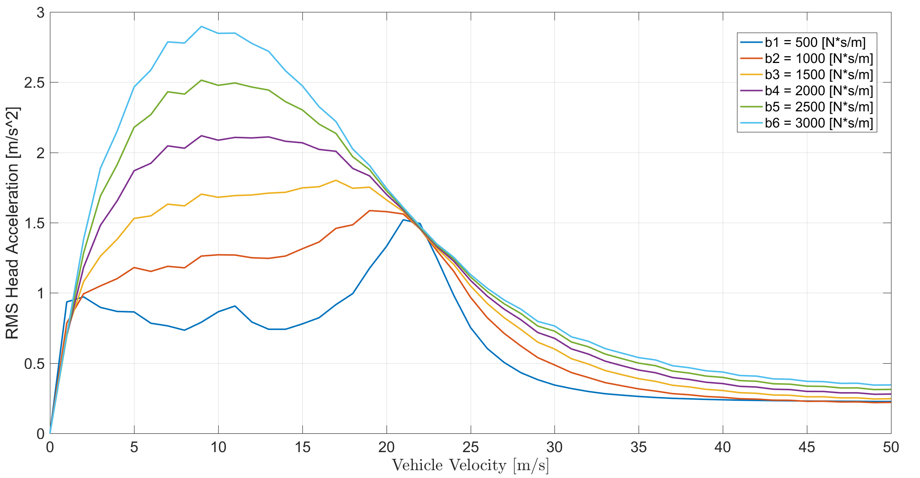
Varying suspension damping with constant stiffness
ME 4534
Drops After ~ 22 m/s
Why?
Notes:
-Stiffness held constant at 10000 N/m
-Ran simulation with Matlab/Simulink. Returned results for damping values from 500 -> 3000 N*s/m
-RMS head acceleration only. Vehicle velocity on the x. Reminder that this is ONLY simulated for lateral vibrations.
-General trend is that RMS accel is less as b decreases. Since Ride Comfort INCREASES with LESS RMS acceleration, we have more comfort at lower damping values. Not intuitive!!
-less exposure to bump at higher speeds
TALK ABOUT ISO STANDARD

Slide 9
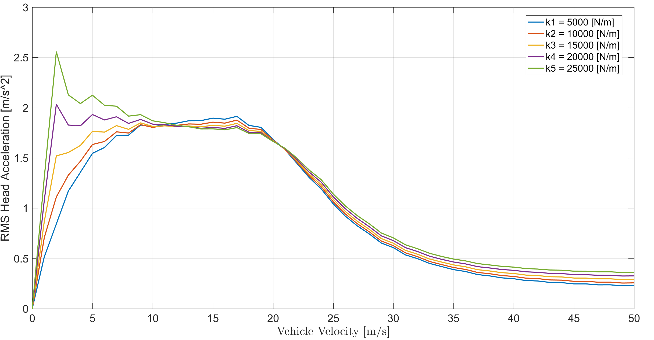
Varying suspension stiffness with constant damping
ME 4534
Drops After ~ 20 m/s
Why?
Notes:
-Damping held constant at 1650 N*s/m
-Adjusted suspension stiffnesses from 5000 -> 25000 N/m
-The differences here are much less drastic than when adjusting the damping coefficients
-Same thing here. Less RMS accel = More comfort
-Crosses twice. Lower stiffness is LESS comfortable between 12 and 20 m/s, but before and after that it is more comfortable

Slide 10
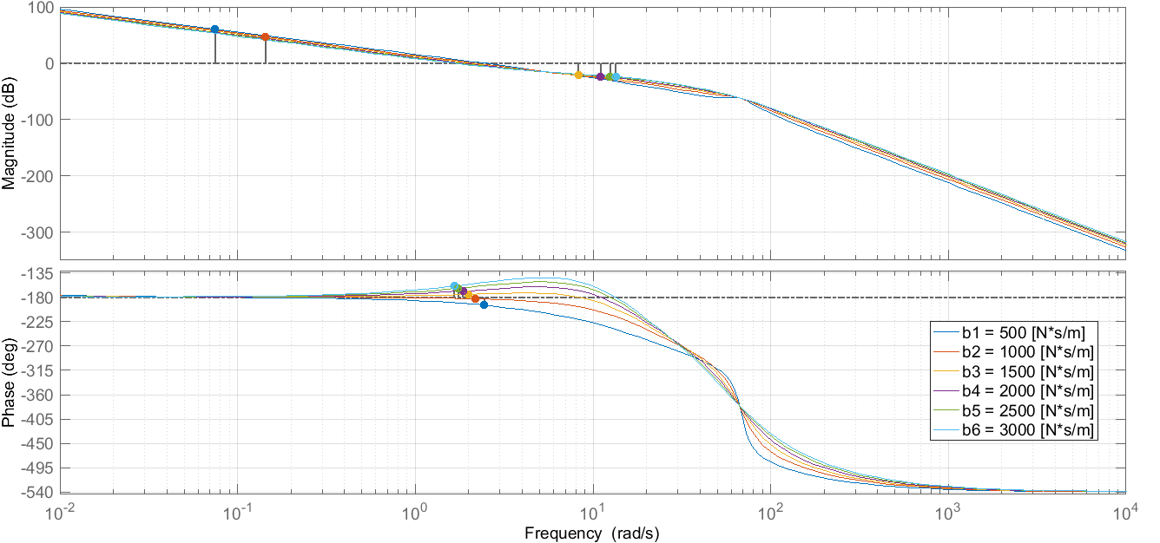
Varying suspension damping with constant stiffness (Bode)
ME 4534
Unstable Gain
Unstable Phase
Notes:
-Stiffness held constant at 10000 N/m
-Open Loop LTI (Linear-Time-Invariant) Transfer Function of the Driver’s Head
-Unstable at 2.18 rad/s and 2.44 rad/s when damping is 500-1000 N*s/m respectively
-Gain unstable at 0.07 rad/s and 0.14 rad/s when damping is 500-1000 N*s/m respectively
-Very close to being unstable even at 1500 N*s/m this is why we select a damping coefficient higher than 1500 N*s/m even when lower damping gives us better ride comfort at lower speeds

Slide 11
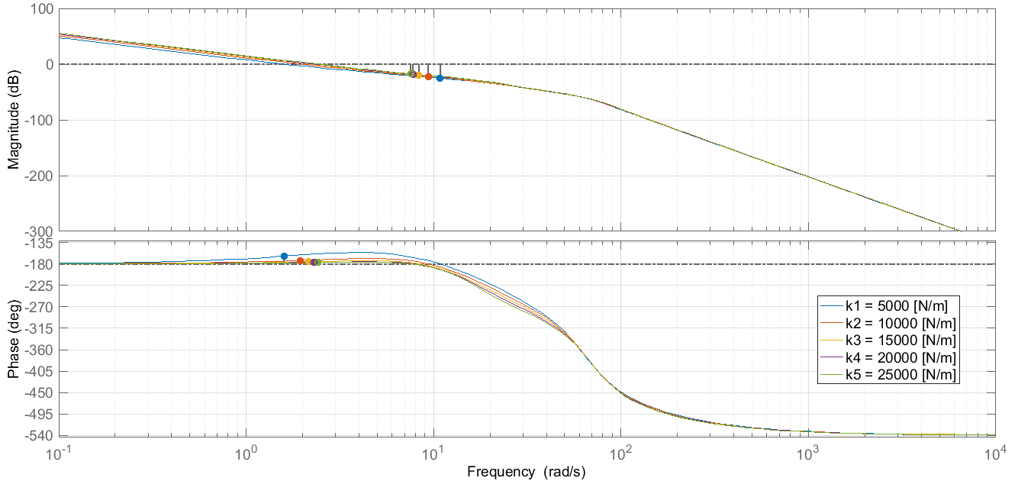
Varying suspension stiffness with constant damping (Bode)
ME 4534
Rider Stability?
Very Close!
Notes:
-Damping held constant at 1650 N*s/m
-Open Loop LTI (Linear-Time-Invariant) Transfer Function of the Driver’s Head
-As stiffness increases it becomes very close to the phase crossover point of 8 rad/s
-Keeping the stiffness low will keep the system further away from the unstable region and improve ride comfort but if stiffness is too low handling will be compromised
-If choose lower stiffness, more vehicle roll, less response to steering,

Slide 12


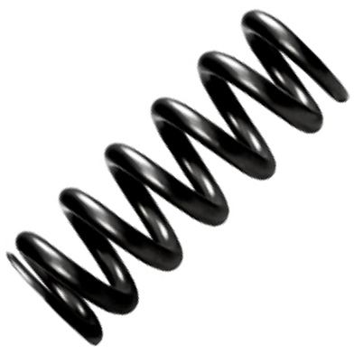
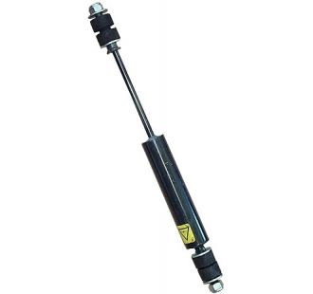

Conclusions
ME 4534
Other Factors?
5000 N/m
1500 N*s/m
Notes:
-Ride comfort plays a role into car safety
-Simulated body + suspension model in Mathematica, ran simulation w/ Simulink
-Team found that ride comfort increases with less damping, and less suspension
-Most optimal values that the team found in term of ride comfort and system stability are ~1500 N*s/m and ~5000 N/m
-But we still have to see how these values would affect other factors, such as ride handling

Slide 13
ME 4534
Questions?

Slide 14
Model Parameters References
ME 4534
Mass for human: Avg. 62 kg, highest 80 kg (https://www.biomedcentral.com/content/pdf/1471-2458-12-439.pdf)
Suspension mass for quarter model: 200 kg (http://folk.ntnu.no/skoge/prost/proceedings/acc09/data/papers/0529.pdf)
Unsprung mass: 24.5 kg (http://folk.ntnu.no/skoge/prost/proceedings/acc09/data/papers/0529.pdf)
Suspension Stiffness: 15.75 kN/m (http://folk.ntnu.no/skoge/prost/proceedings/acc09/data/papers/0529.pdf)
Unsprung Mass Stiffness: 157 kN/m (Masi, John. “Effect of Control Techniques on the Performance of Semiactive Dampers.”)

Slide 15
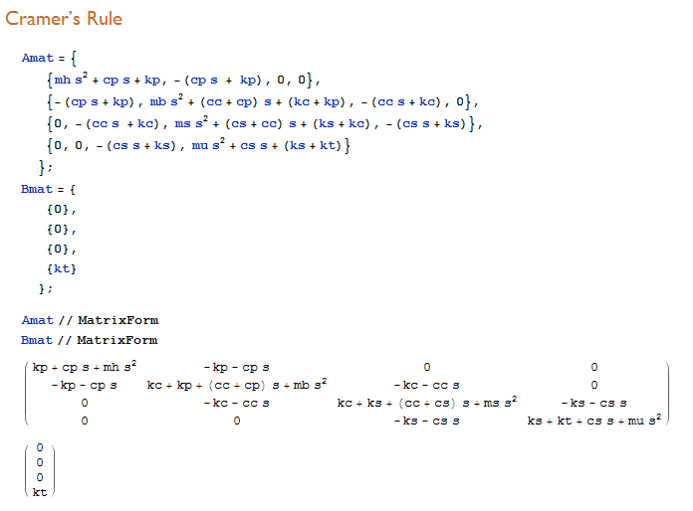
Solving for each Transfer Function in Mathematica
ME 4534
Setup equations in matrix
Use Cramer’s Rule to solve
Solves G_{H}(s), G_{B}(s), G_{S}(s), and G_{U}(s)

Slide 16
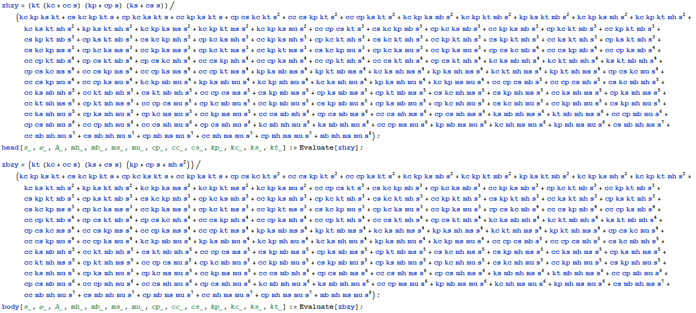
G_{H}(s) and G_{B}(s) are absolutely horrendous...
ME 4534

Slide 17
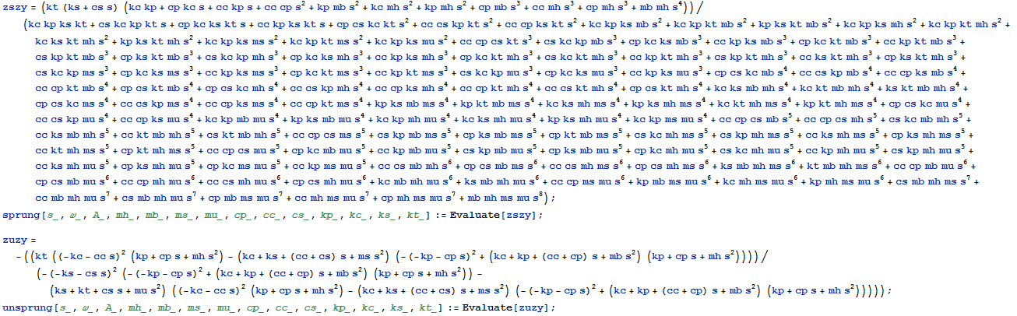
G_{S}(s) and G_{U}(s) are ALSO absolutely horrendous...
ME 4534

Slide 18
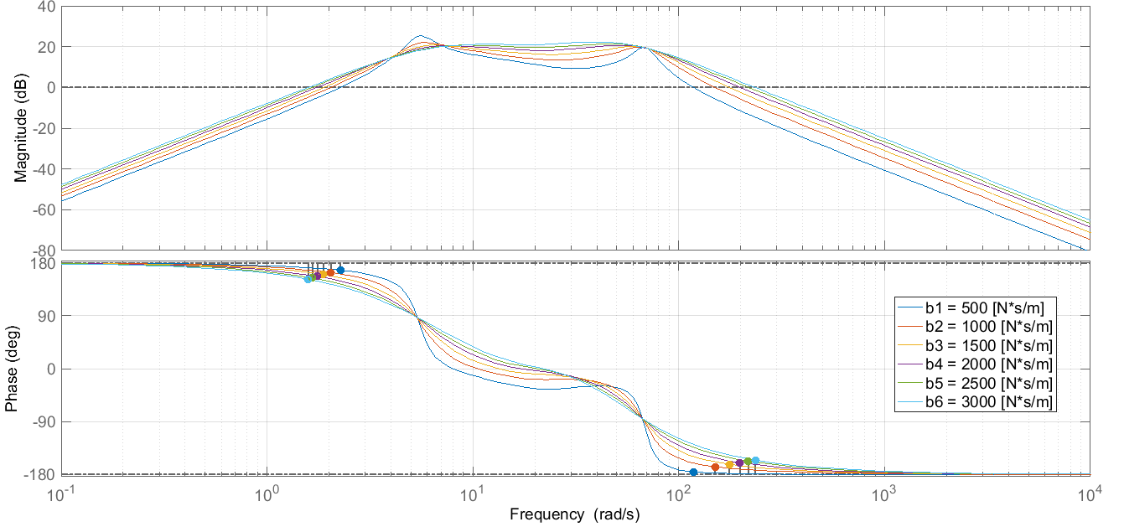
Bode plot - varying damping with constant stiffness
ME 4534
Primary
Secondary
Notes:
-Natural frequencies occur at 5.5 rad/s and 70 rad/s
-Magnitude at natural frequencies seems to stay around 20 dB
-System appears to have two crossover frequencies at 1.5-2.5 rad/s and another at 100-200 rad/s depending on the damping
-Phase shift harshness at natural frequencies appears to decrease as one would expect with increased damping

Slide 19
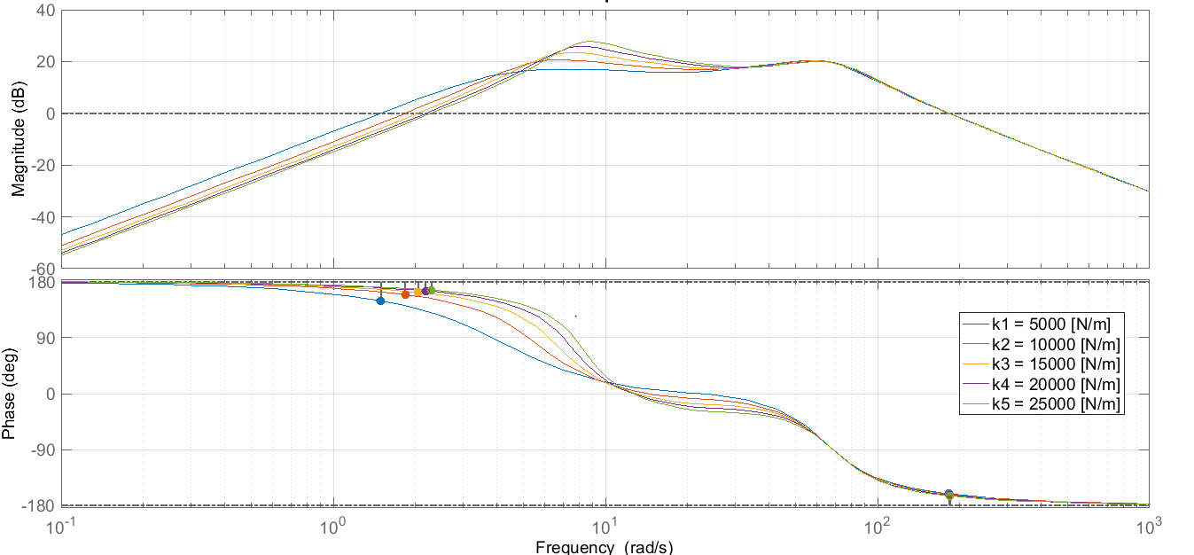
Bode plot - varying stiffness with constant damping
ME 4534
Primary
Secondary
Notes:
-Natural frequencies vary greatly at lower ranges 4-10 rad/s but appear to regroup around 70 rad/s
-Magnitude at natural frequencies vary from 10-20 dB for the first ranges of natural frequencies but then stick at 20 dB at the second set of natural frequency
-System appears to have two crossover frequencies at 1.5-2.5 rad/s and another at around 180 rad/s depending on the stiffness
-Phase shift harshness at natural frequencies appears to increase as one would expect with increased stiffness

Slide 20
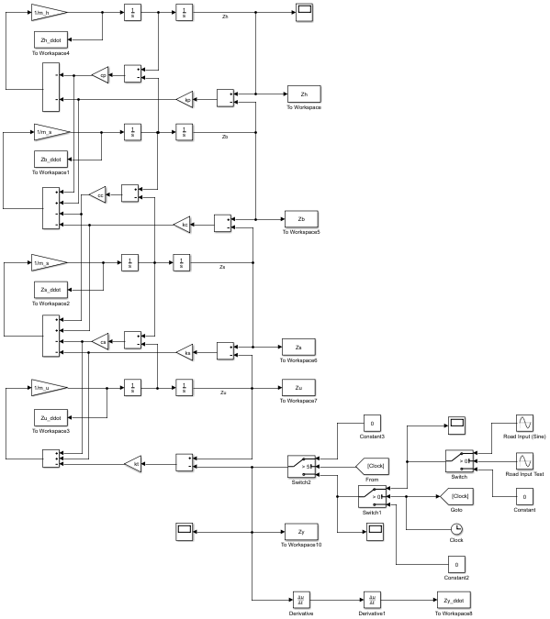
Simulink Model
ME 4534
May seem more complicated but easier to retrieve response data
Robust/easily changeable

Slide 21
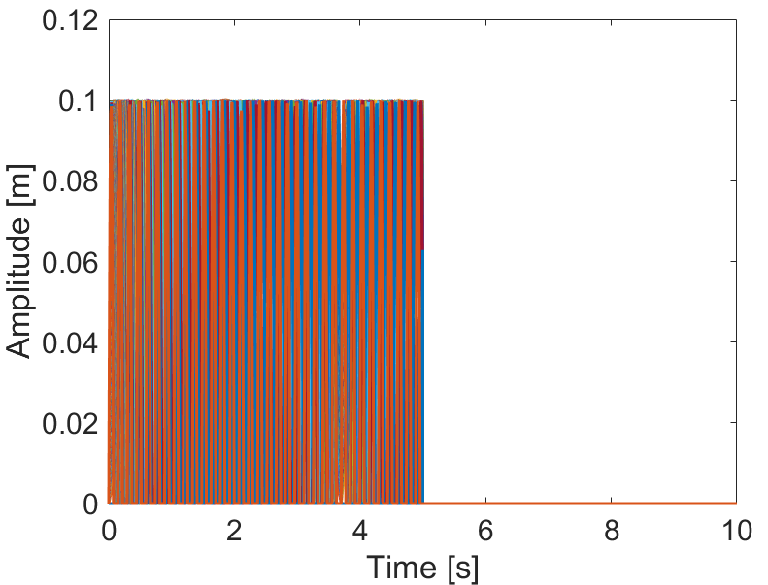
Road input for a range of velocities
ME 4534
May seem more complicated but easier to retrieve response data
Robust/easily changeable

